Slide 1
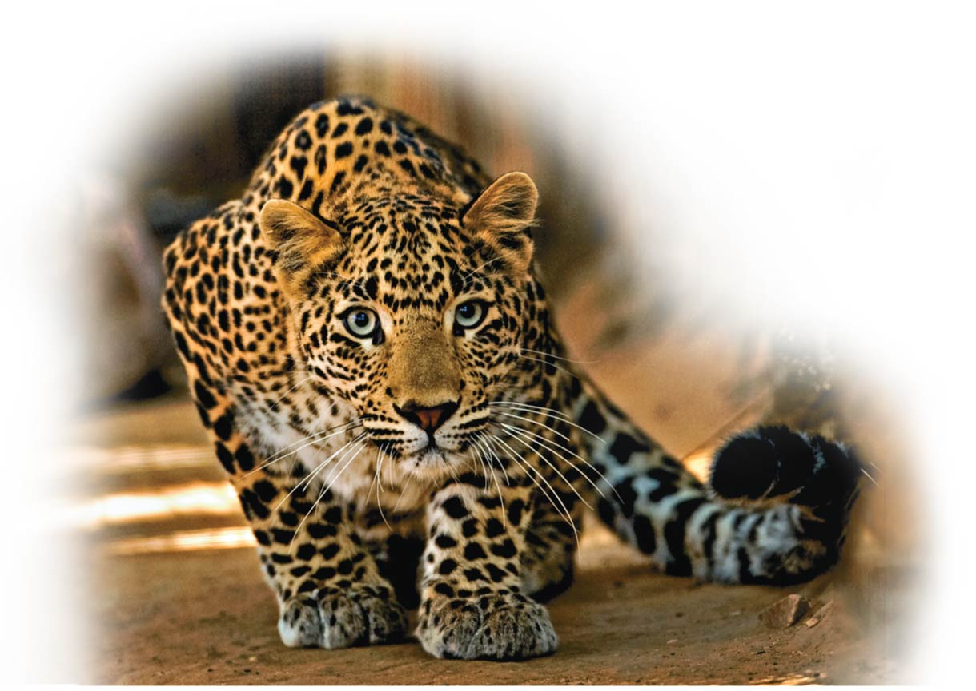
How Genes Are Controlled
Unit 2; Chapter 11

Slide 2
Learning Objectives 1
Explain how gene regulation leads to cells with many different properties.
Explain how the lac operon works, and compare it to the mechanism of operons that control amino acid synthesis in bacteria.

Slide 3
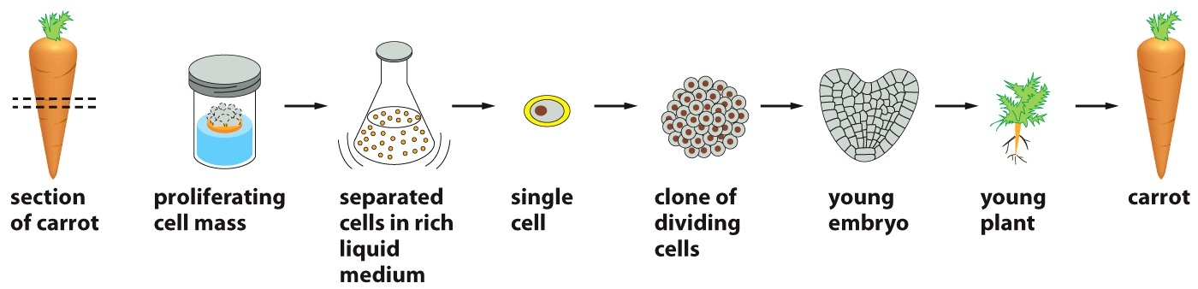
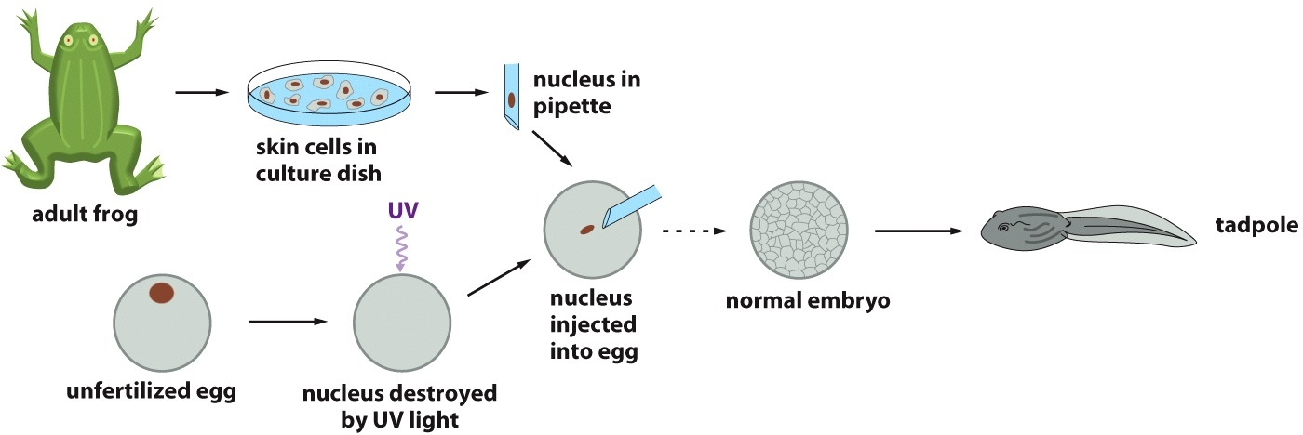
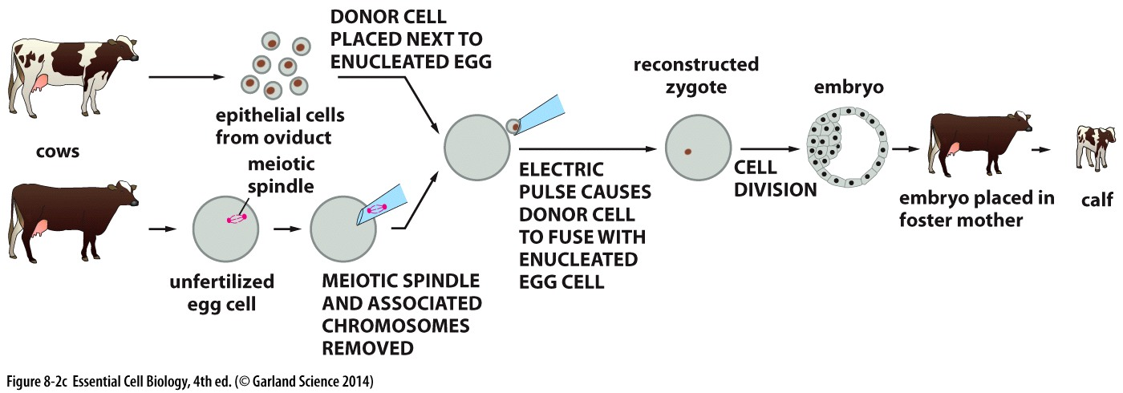

Slide 4
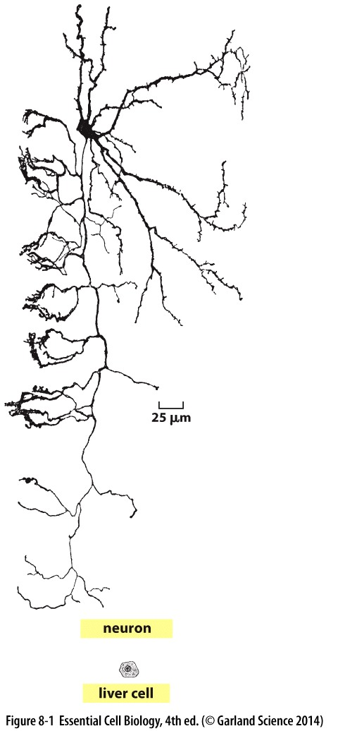
Why and How Genes Are Regulated
Cells with the same genetic information can develop into different types of cells
  For specialization of cells within the body.
  Through gene regulation, mechanisms that turn on certain genes while other genes remain turned off.
    A gene that is turned on is being transcribed into mRNA, and that message is being translated into specific proteins.
Gene expression, the overall process by which genetic information flows from genes to proteins.

Slide 5
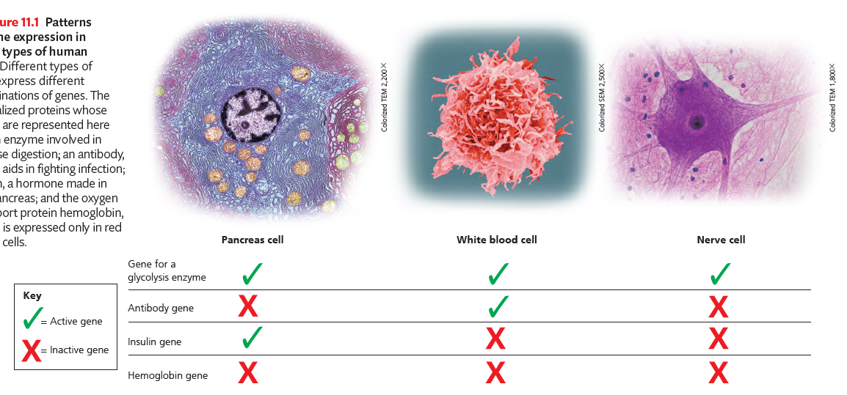
Different Cell Types Produce Different Sets of Proteins
Housekeeping

Slide 6
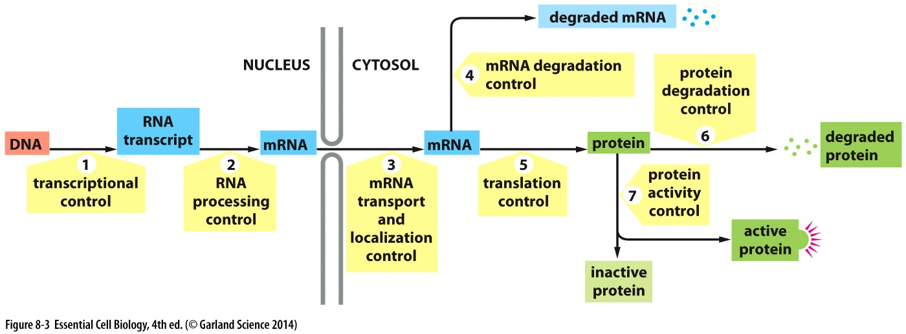
Gene Expression Can Be Regulated at Various Steps

Slide 7
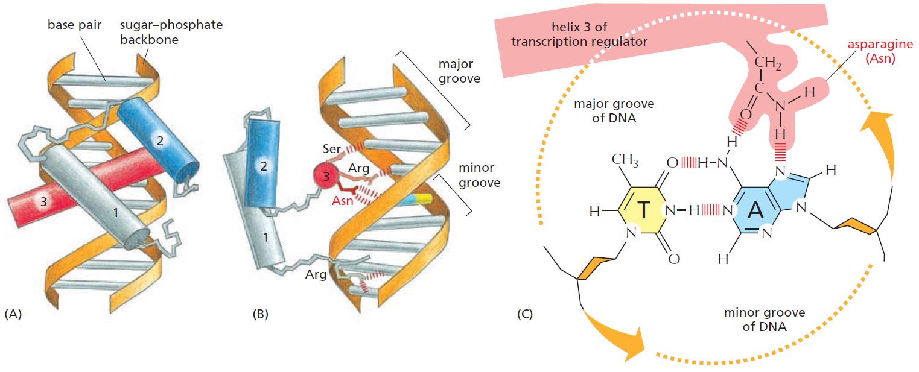
How Transcriptional Switches Work
Transcription Regulators Bind to Regulatory DNA Sequences

Slide 8
Gene Regulation in Bacteria
Express as needed
In response to increase lactose, E. coli express three genes, together, for enzymes that enable the bacterium to absorb and digest this sugar.
  The organization of the three genes, adjacent in the DNA and turned on and off as a single unit
After the lactose is gone, these genes are turned off.
This regulation is achieved through short stretches of DNA that help turn all three genes on and off at once, coordinating their expression.

Slide 9
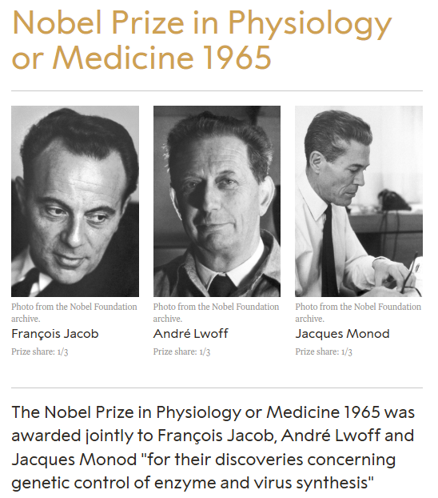
Lac Operon
Such a cluster of related genes and sequences that control them is called an operon (操纵子).
The operon considered here is the lac operon (乳糖操纵子).

Slide 10
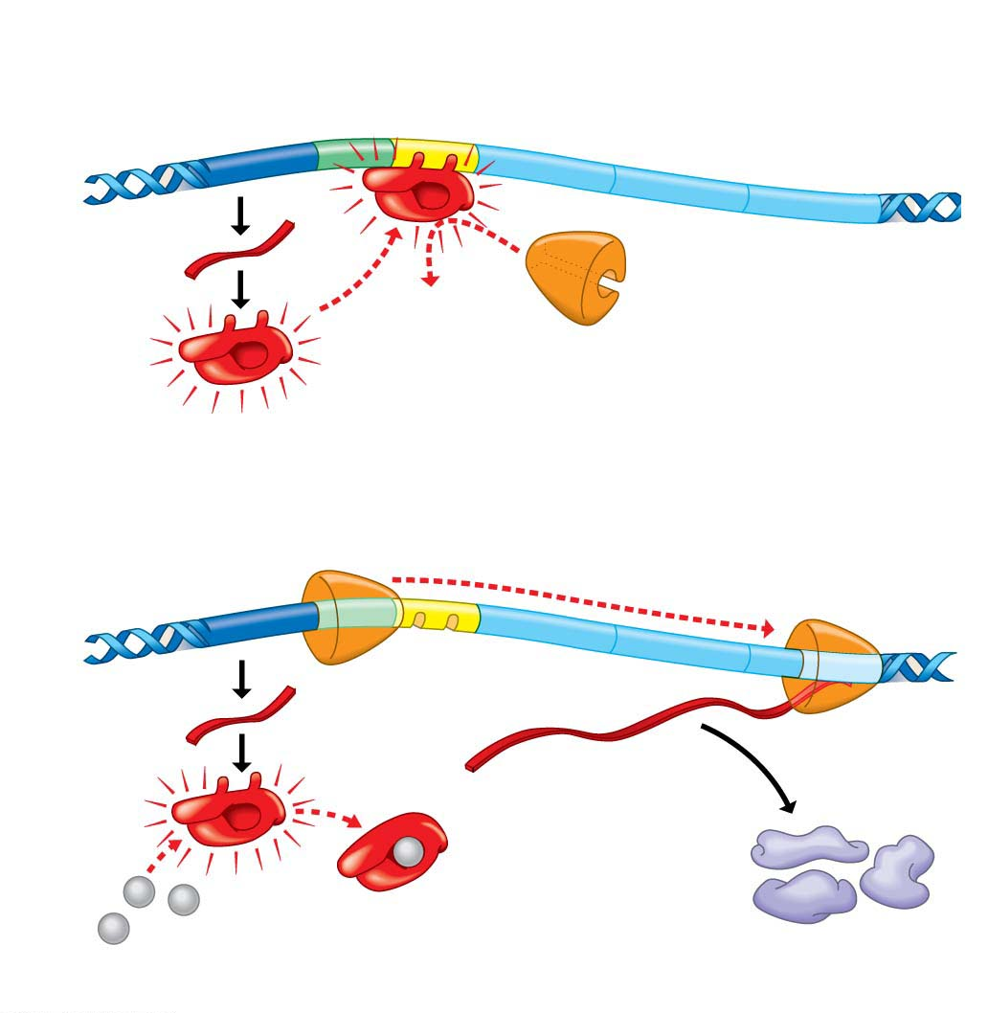
Operon
Two control sequence in DNA
  Promoter (启动子), is the site where the enzyme RNA polymerase attaches and initiates transcription.
  Operator (操纵基因) acts as a switch that is turned on or off, depending on whether a specific protein is bound there.
The specific protein, repressor, if active, binds to the operator.
Cluster of genes for
lactose enzymes
Regulatory
gene
Operator
Promoter
DNA
mRNA
1
2
Protein
Active
repressor
RNA polymerase cannot attach to promoter
Operon turned off (lactose absent)
4
Transcription
DNA
RNA polymerase
bound to promoter
3
3
mRNA
mRNA
5
Translation
2
2
Protein
1
1
Inactive
repressor
Lactose
Lactose enzymes
Operon turned on (lactose inactivates repressor)

Slide 11
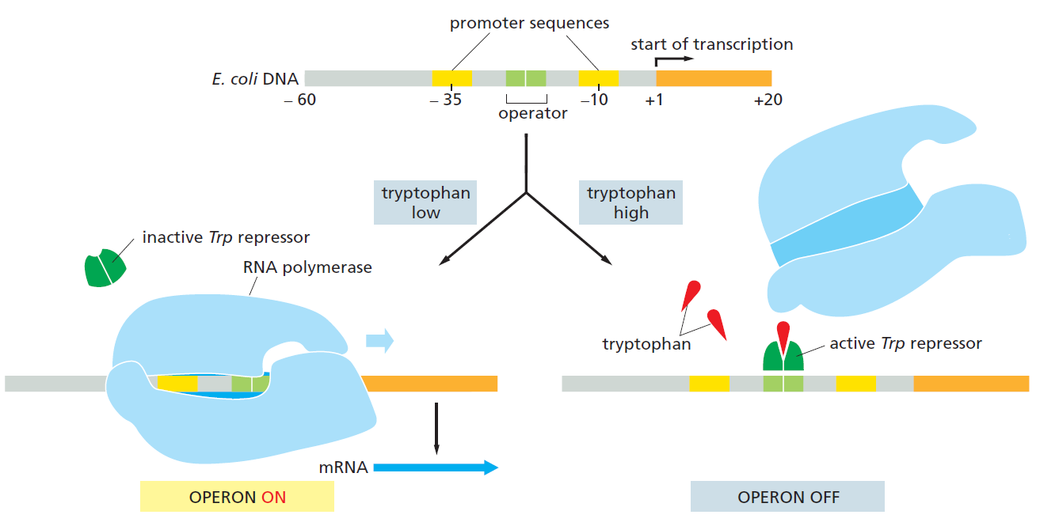
Genes Turned off by Repressor Proteins

Slide 12
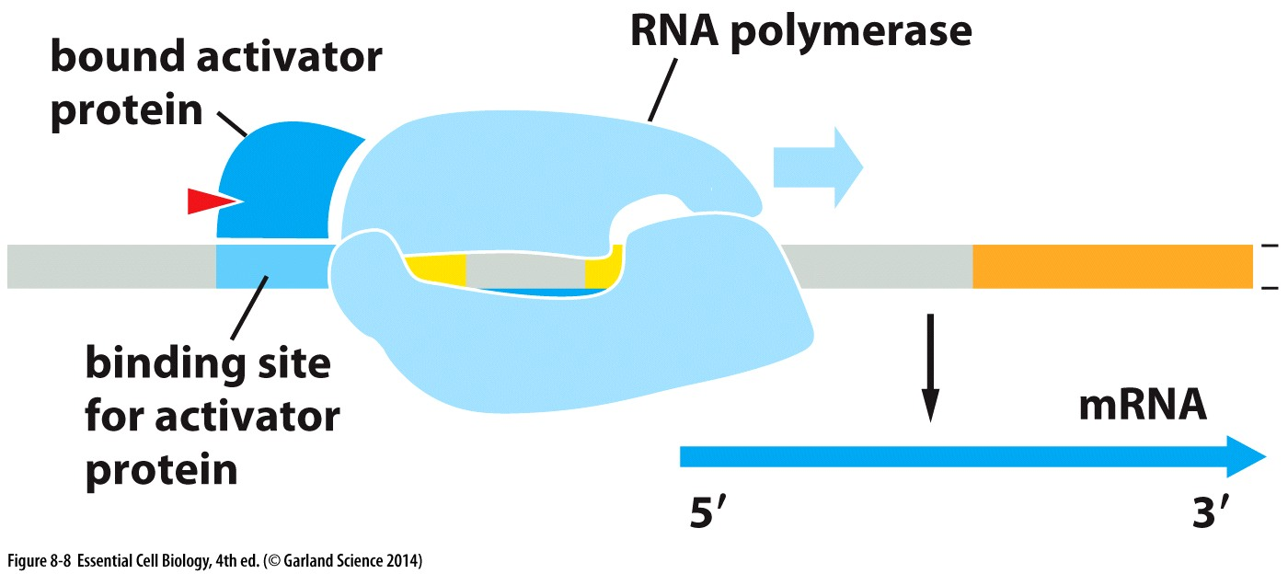
Genes Turned on by Activator Proteins

Slide 13
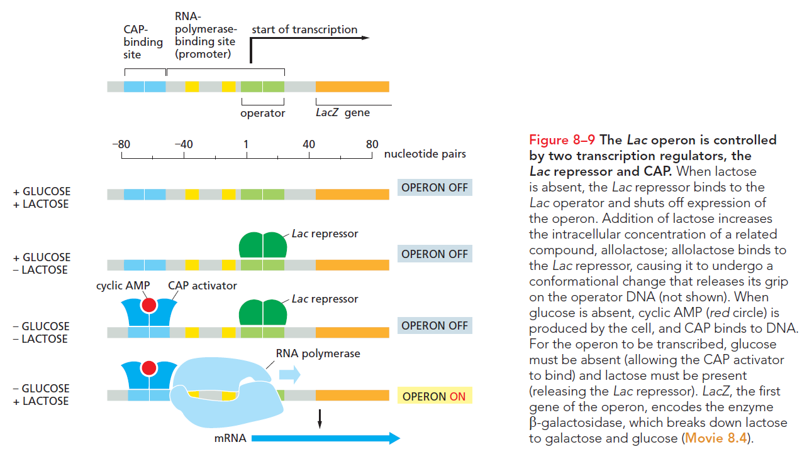
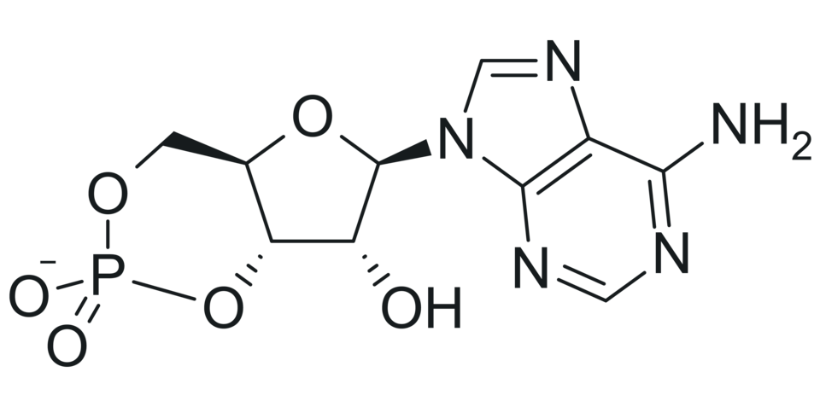
cyclic AMP (cAMP)

Slide 14
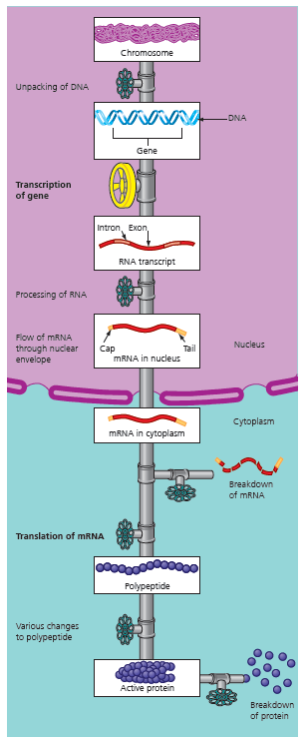
Gene Regulation in Eukaryotic Cells
LO: Explain how transcription is regulated in eukaryotes and compare transcriptional regulation in eukaryotes and prokaryotes.
Pre-transcriptional control
Transcriptional control
Post-transcriptional control
Translational control
Post-translational control

Slide 15
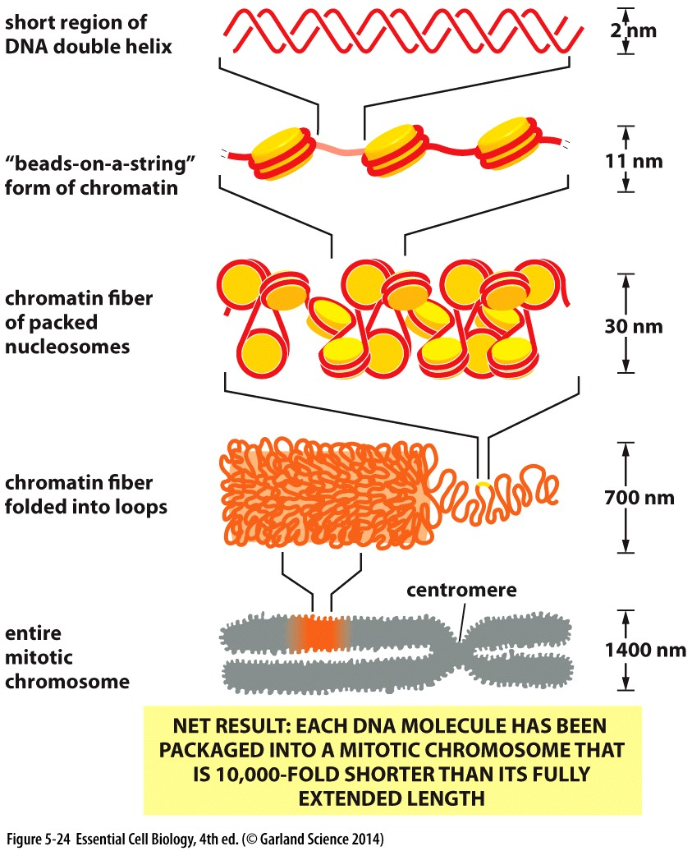
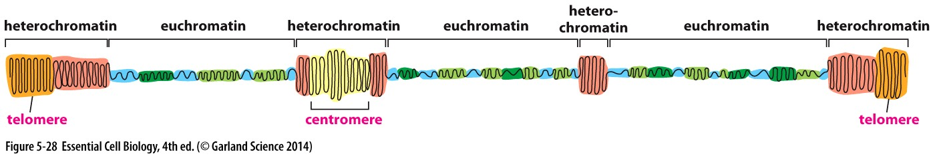
The Regulation of DNA Packing
DNA packing tends to prevent gene expression.
Cells may use DNA packing for the long-term inactivation of genes
  Heterochromatin: a tightly packed (darkly staining) form of DNA or condensed DNA.

Slide 16
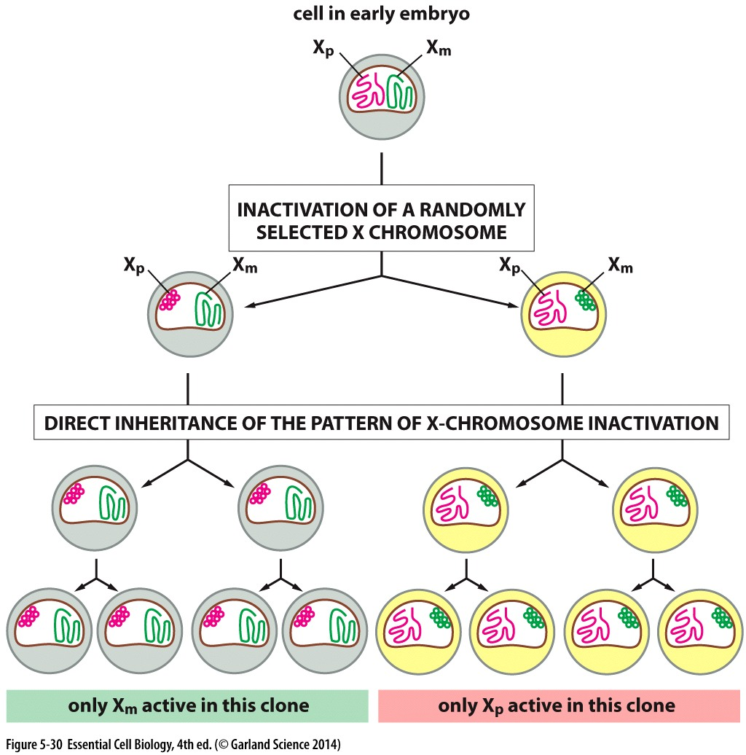
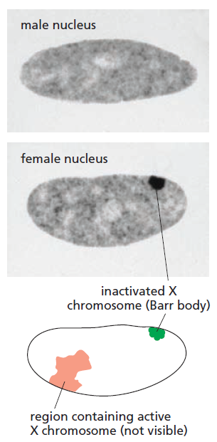
X Chromosome Inactivation
Barr body

Slide 17
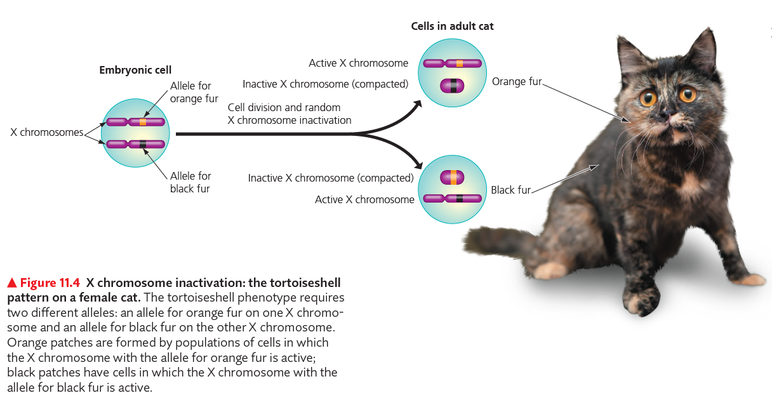
Tortoiseshell Cats

Slide 18
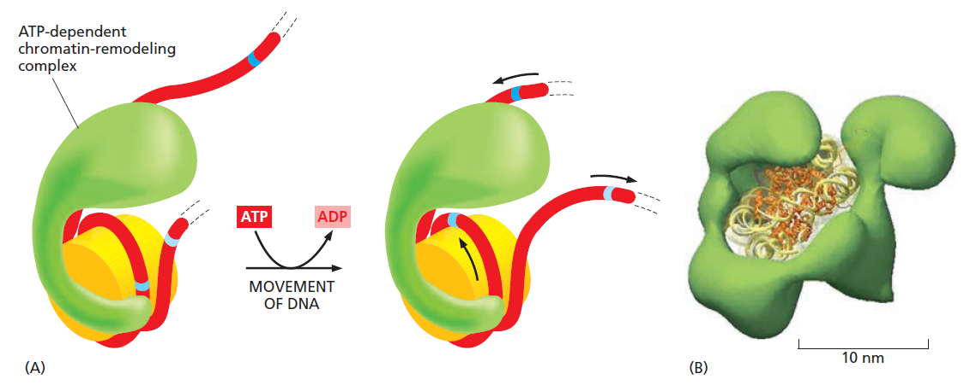
In Euchromatin
Loosely Packed Areas of Active Genes
Still needs to be “unpacked” before it can be transcribed
Chromatin remodeling complex pushes aside nucleosomes

Slide 19
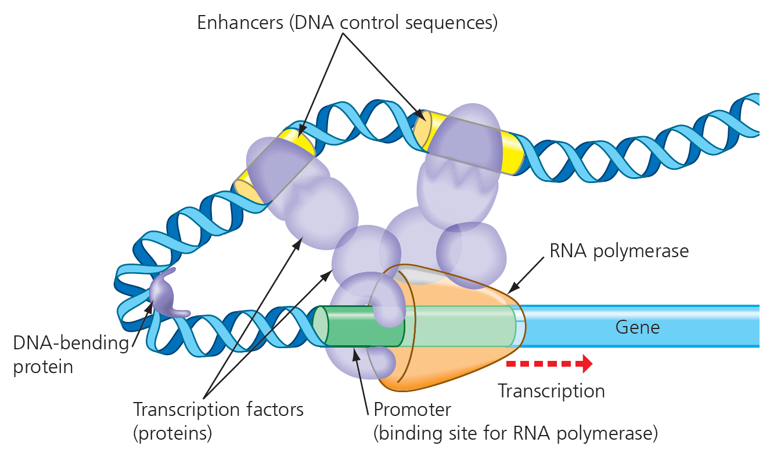
The Initiation of Transcription
The most important stage for regulating gene expression
The binding of RNA polymerase to promotor requires the assistance of transcription factors (TFs, proteins)
  Enhancers (DNA) by activators (TFs) to facilitate
  Silencers (DNA) by repressors(TFs) to inhibit
    Less common
  “Off”, as the default state for most genes
    ~20% of protein-coding genes

Slide 20
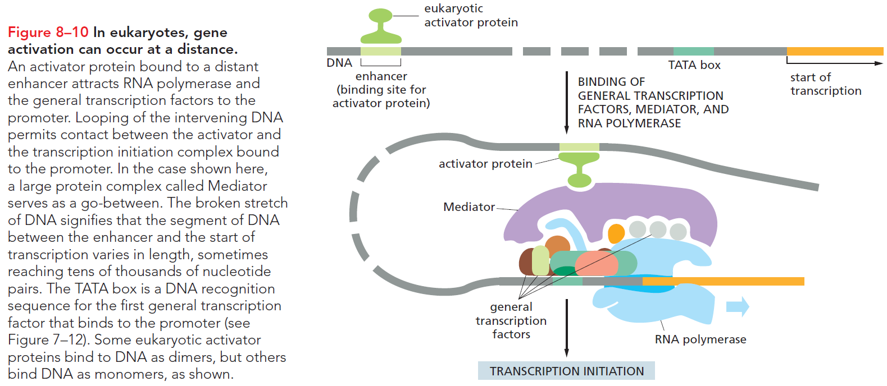
Regulators Control Gene Expression from a Distance

Slide 21
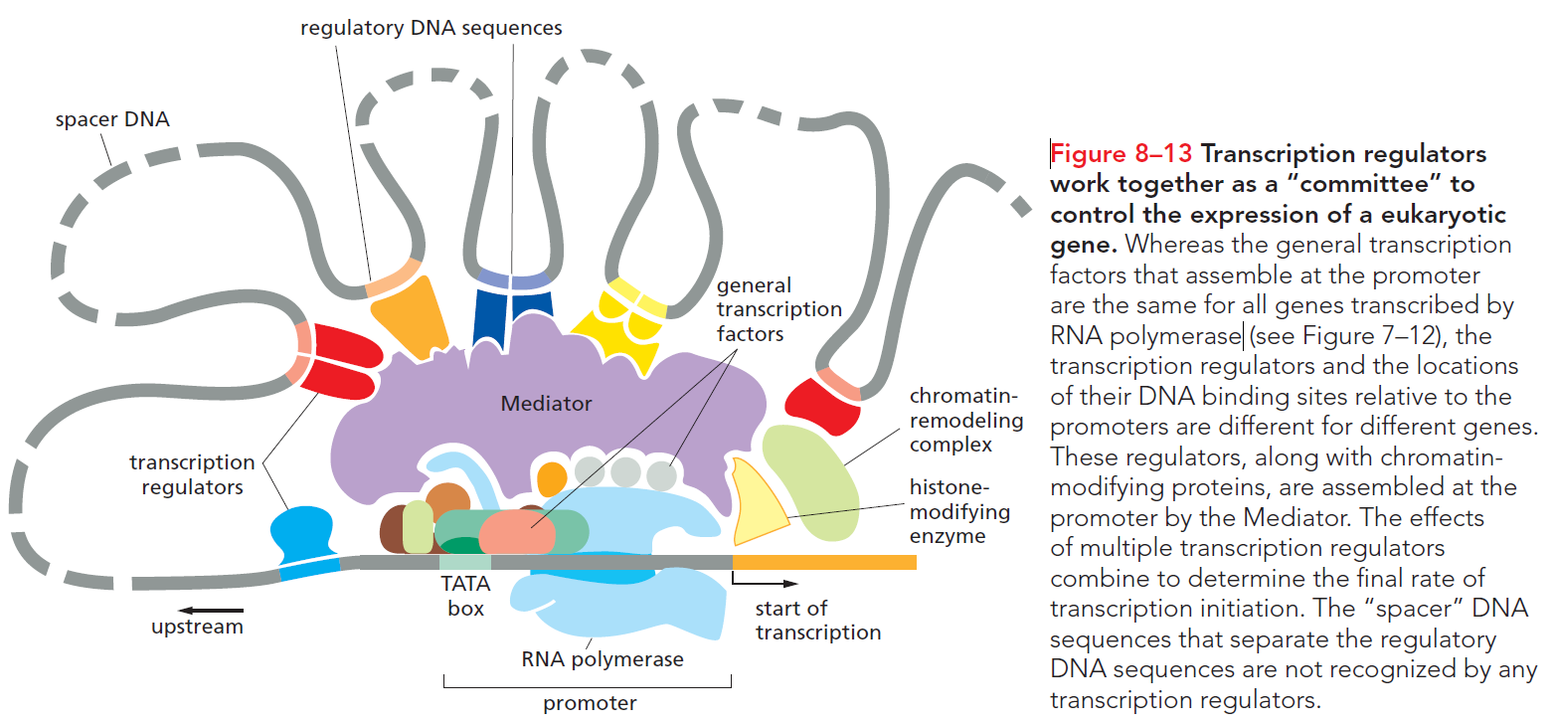
Transcription Initiation Complex

Slide 22
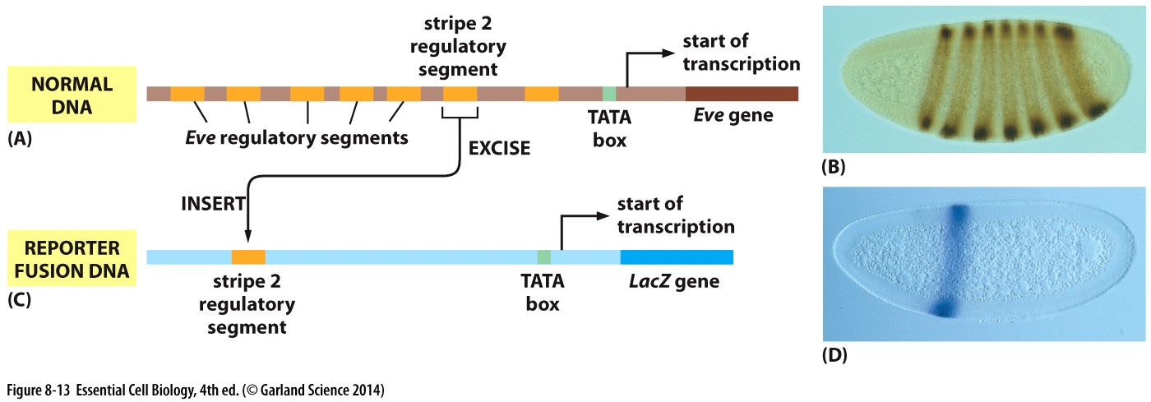
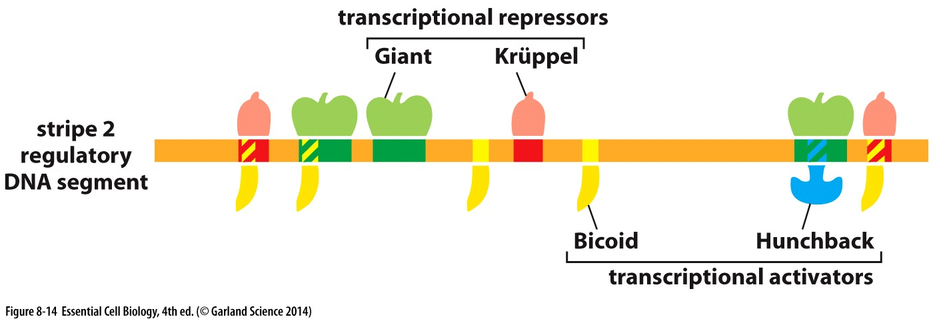
Even-skipped—Eve

Slide 23
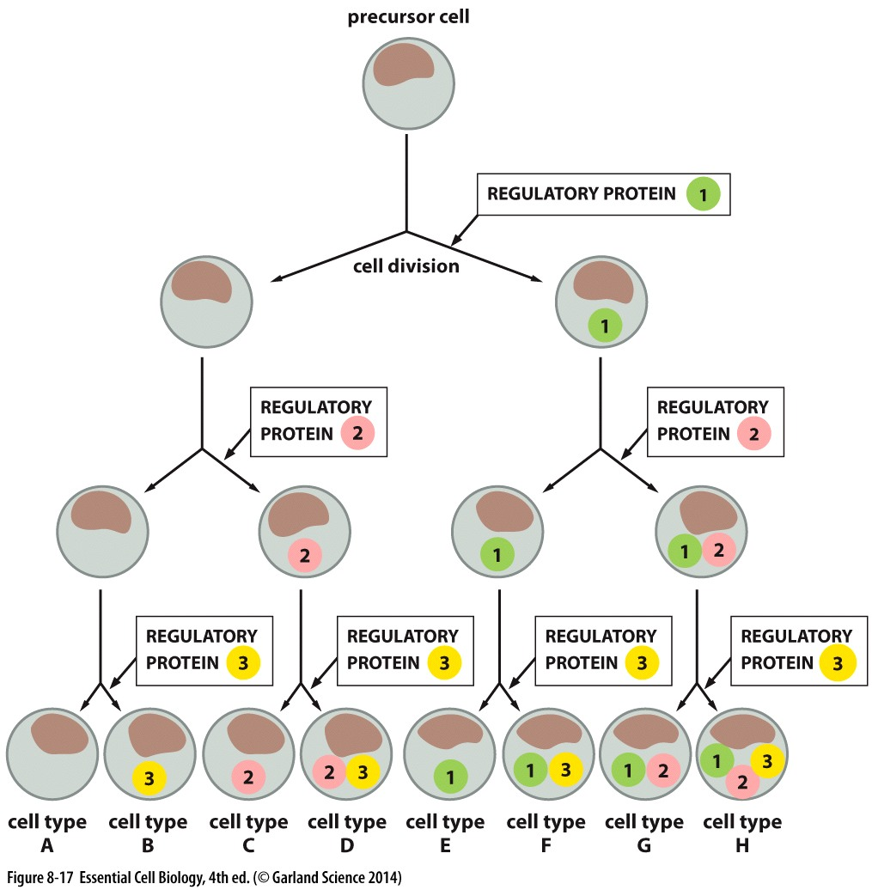
Combinatorial Control Can Generate Different Cell Types
Approximately 1000 transcription regulators
To control the 24,000 genes

Slide 24
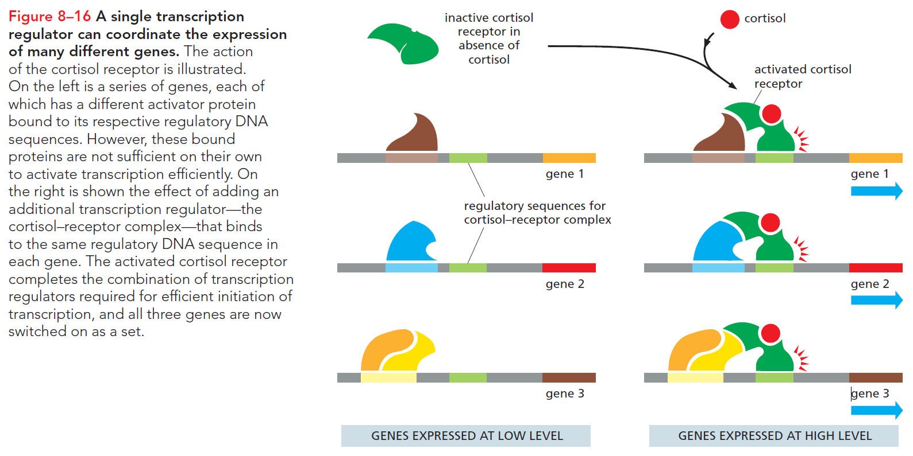
Coordination of Gene Expression by a Single TF

Slide 25
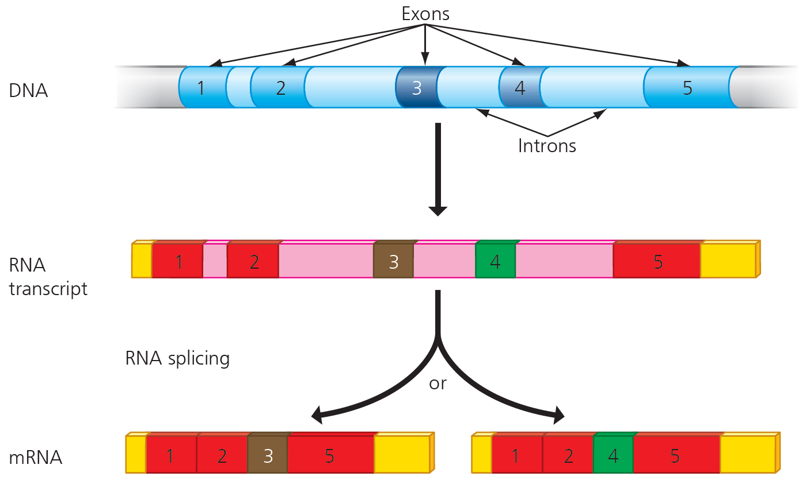
RNA Processing and Breakdown
Processing
  Addition of a cap and tail
  Removal of any introns
  Splicing together of the remaining exons
    Alternative RNA splicing
    multiple mRNAs from the same gene
Breakdown
  Mature mRNA’s “lifetime”, highly variable
  From hours to weeks to months, all eventually broken down

Slide 26
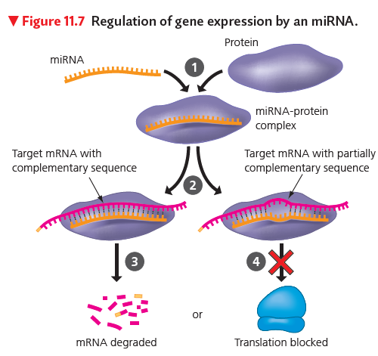
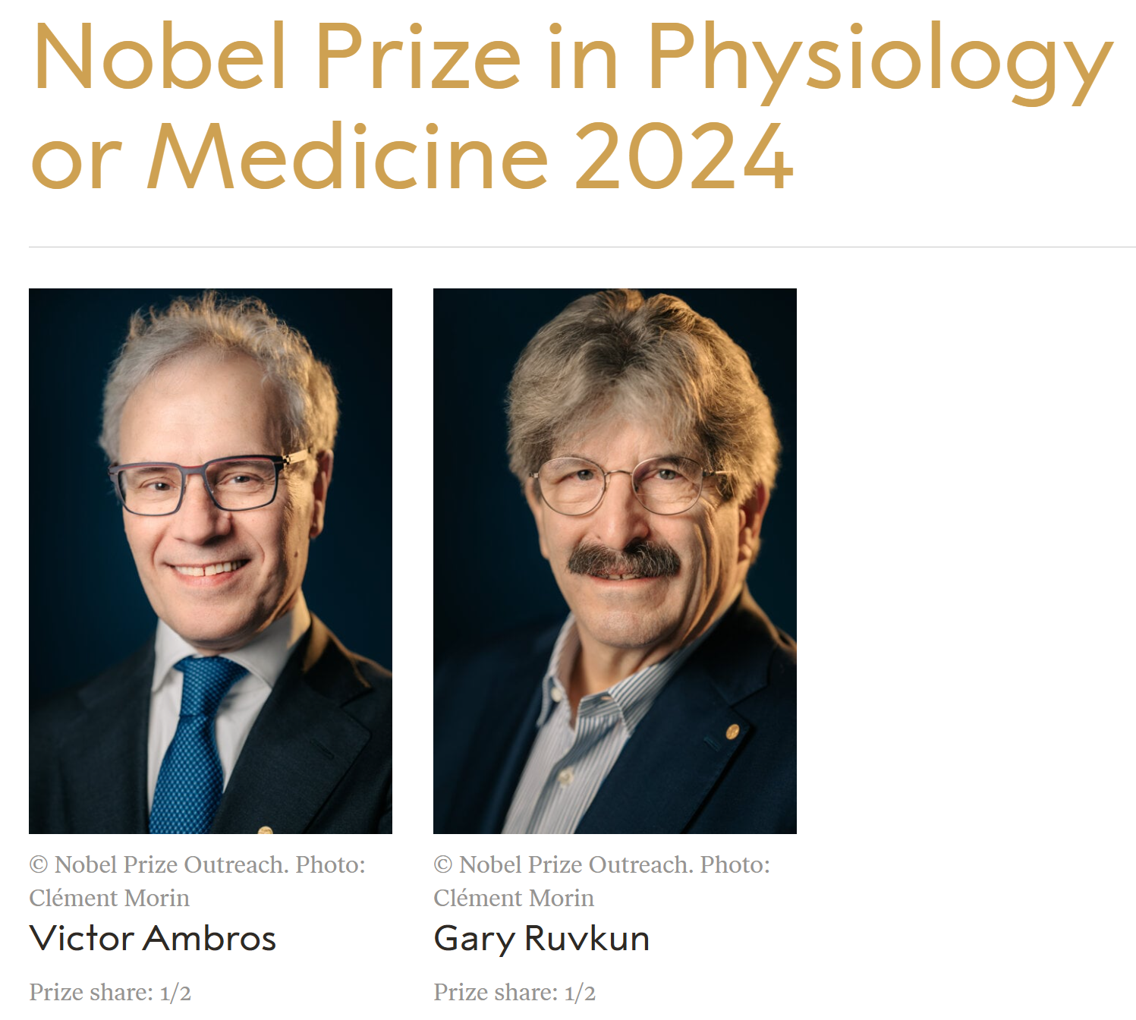
microRNAs (miRNAs), Non-protein Coding RNAs
Base-pair to complementary sequences in messenger RNA (mRNA)

Slide 27
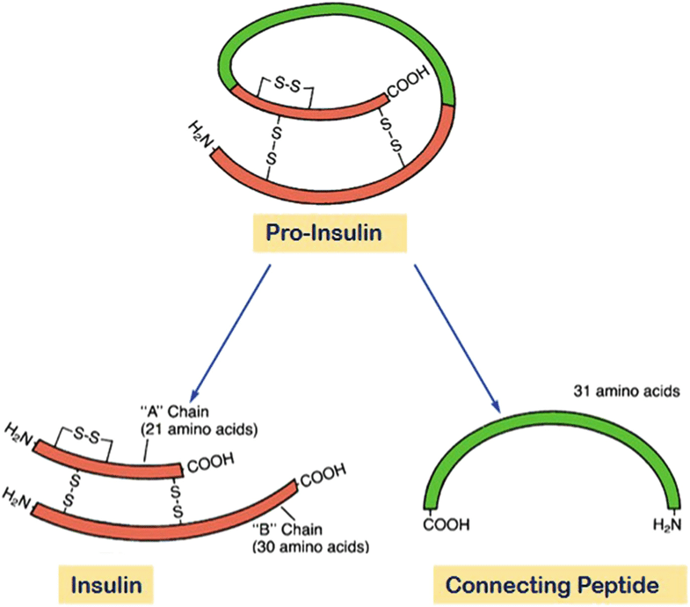
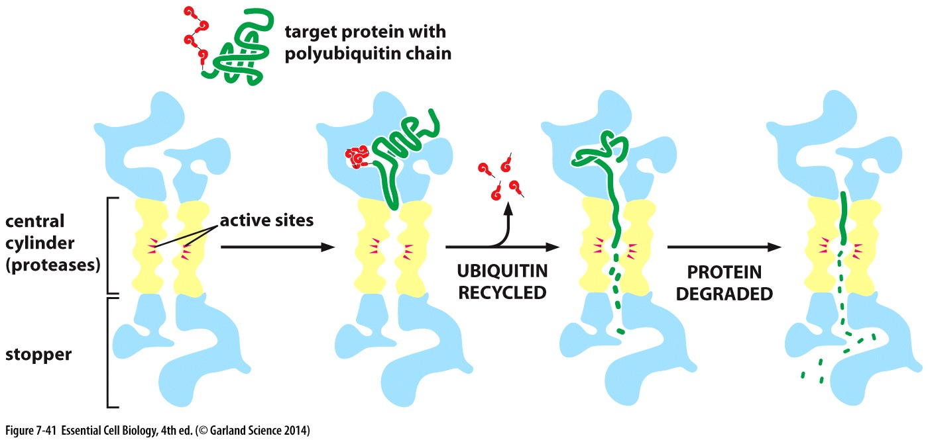
Protein Activation and Breakdown
Activation by
  Cleavage, activation of insulin (胰岛素), trypsin (胰蛋白酶)
  Chemical modification, e.g., phosphorylation by kinase
Selective ubiquitin-mediated breakdown of proteins
https://share.google/images/eg9y9xSEm6ZHmEUD3

Slide 28
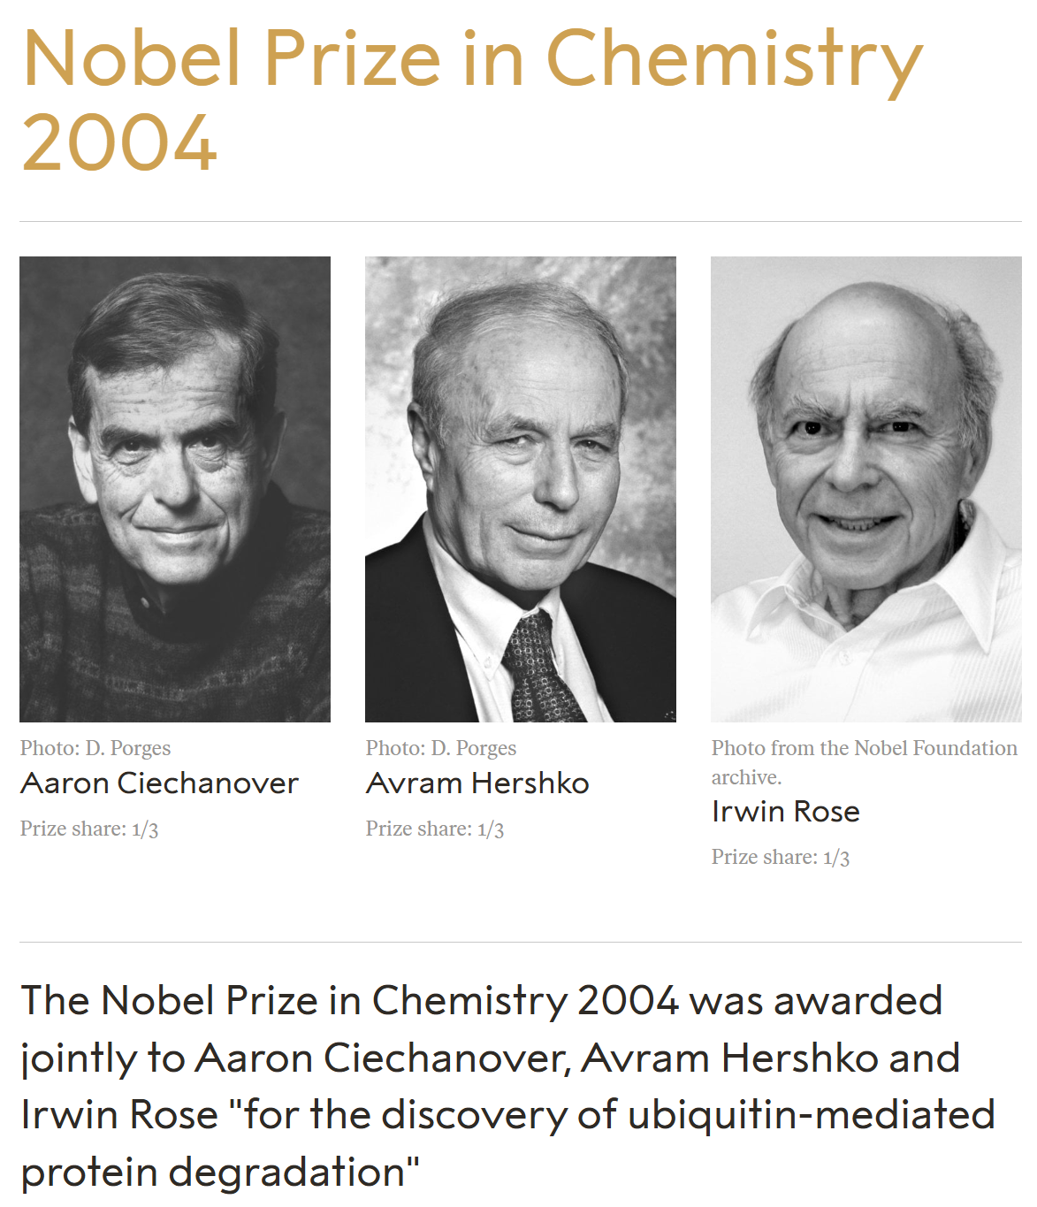
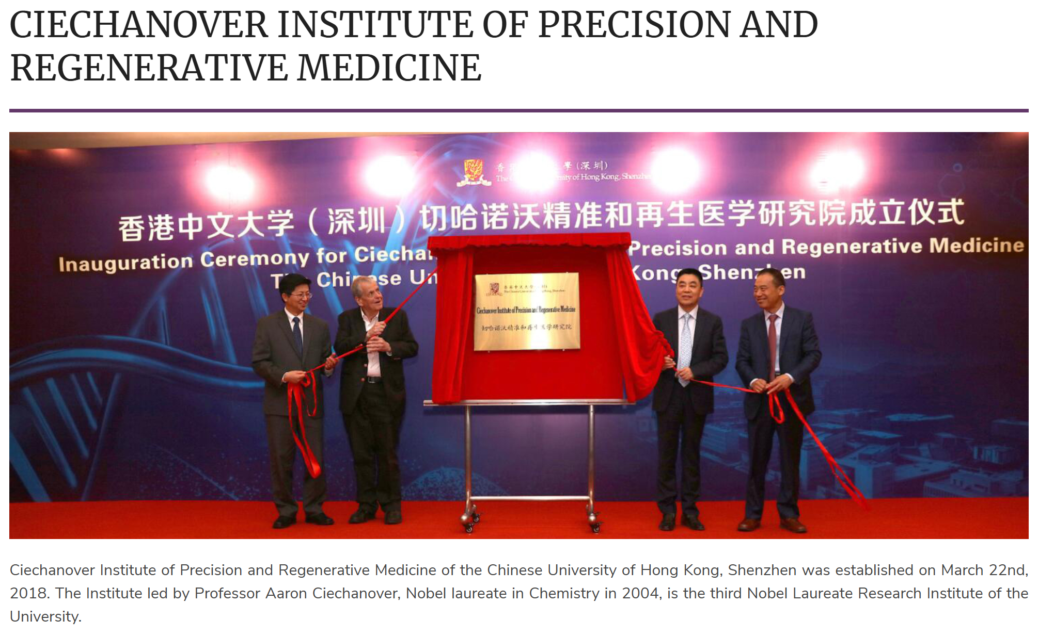

Slide 29
Learning Objectives 2
Describe the significance of cell signaling and homeotic genes in multicellular organisms.
Explain how mutations in proto-oncogenes and tumor suppressor genes can lead to cancer.
Evaluate how personal habits and individual choices can affect a person’s risk of developing cancers.
Evolution Connection: The Evolution of Cancer in the Body
Explain how populations of cancer cells evolve.

Slide 30
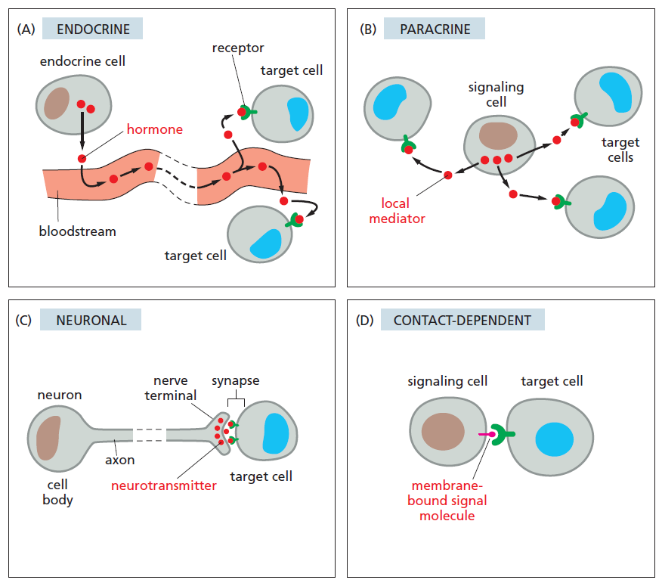
Cell-to-cell Signaling
In a multicellular organism:
Gene regulation can cross cell boundaries, allowing information to be communicated between and among cells.

Slide 31
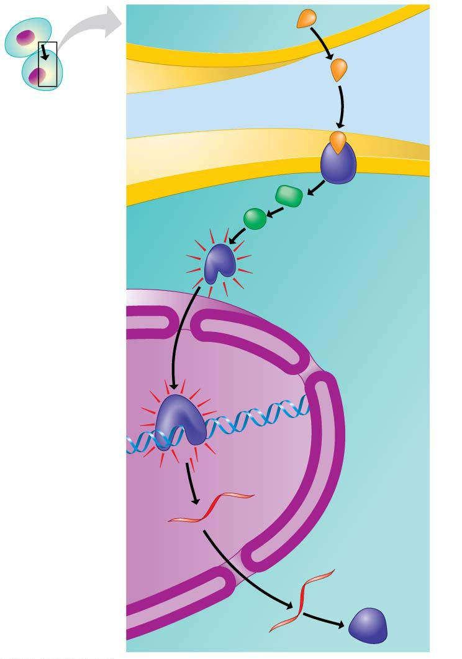
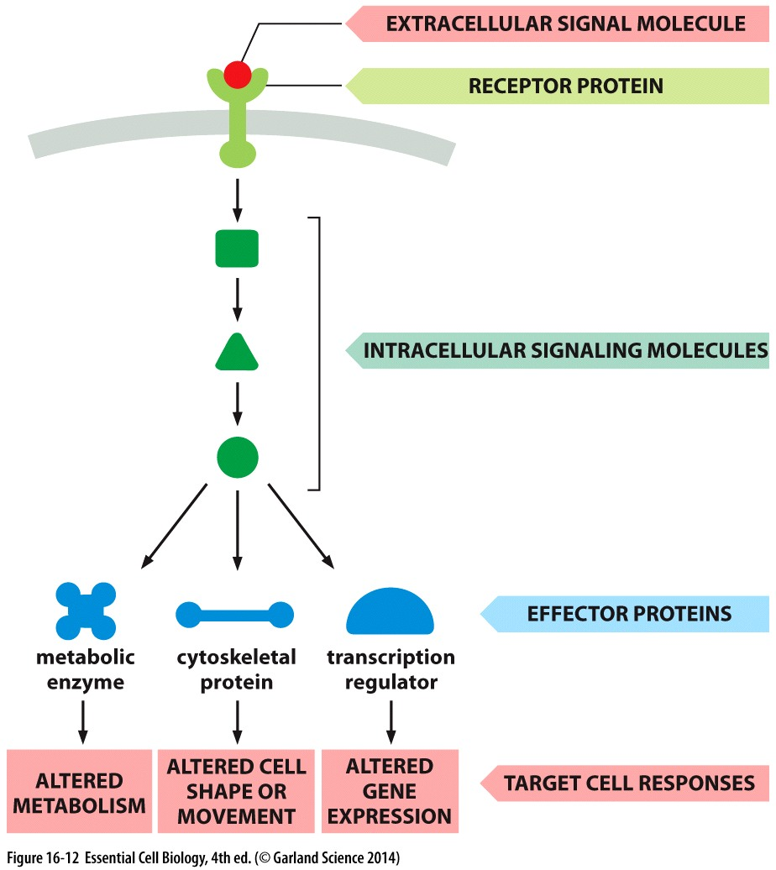
SIGNALING CELL
1
1
Signal
molecule
Plasma
membrane
2
2
3
3
4
4
Receptor
protein
TARGET
CELL
Relay
proteins
Transcription
factor
(activated)
Nucleus
5
5
Transcription
mRNA
New
protein
6
6
Translation

Slide 32
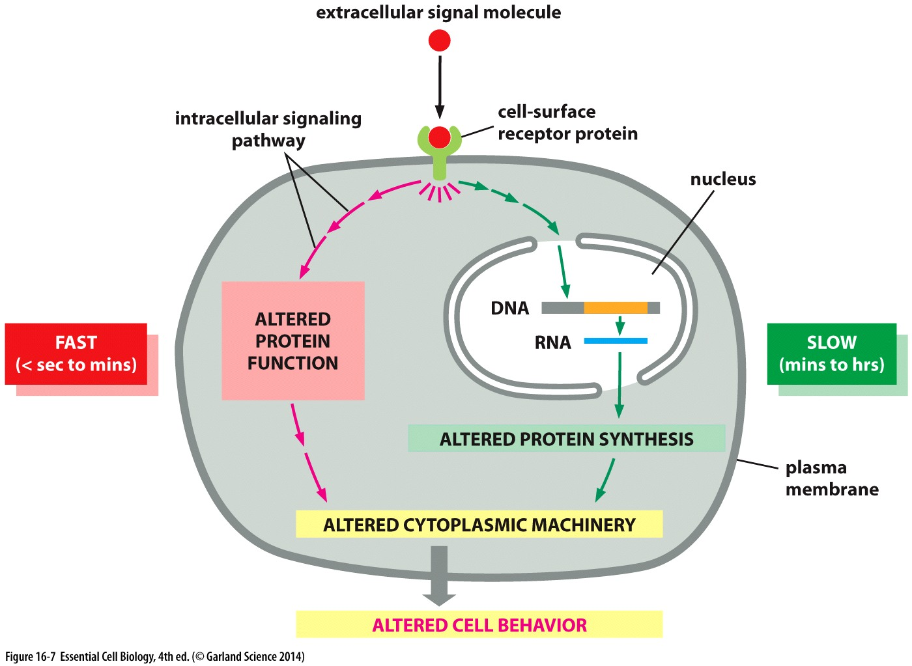
A Cell’s Response to a Signal Can be Fast or Slow

Slide 33
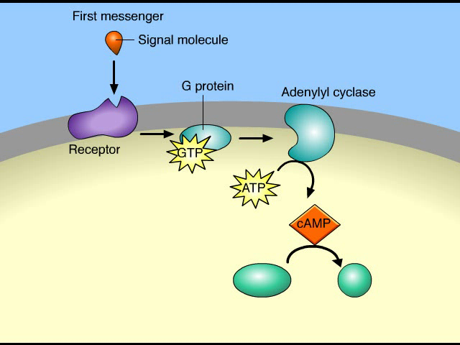
Signal Transduction Pathways

Slide 34
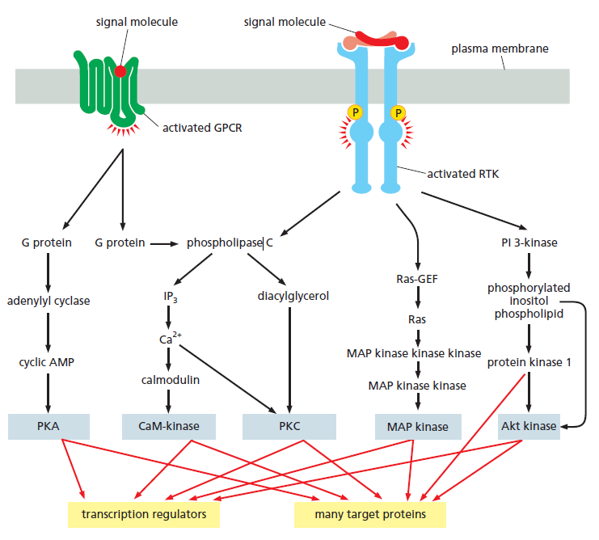
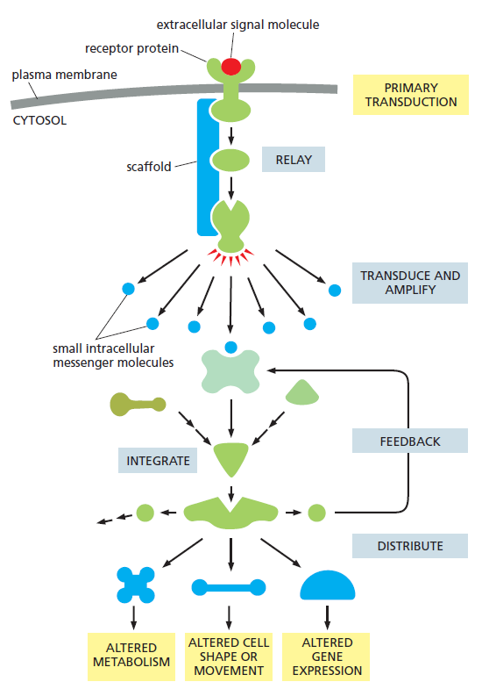
Multiple Pathways and Diverse Intracellular Proteins

Slide 35
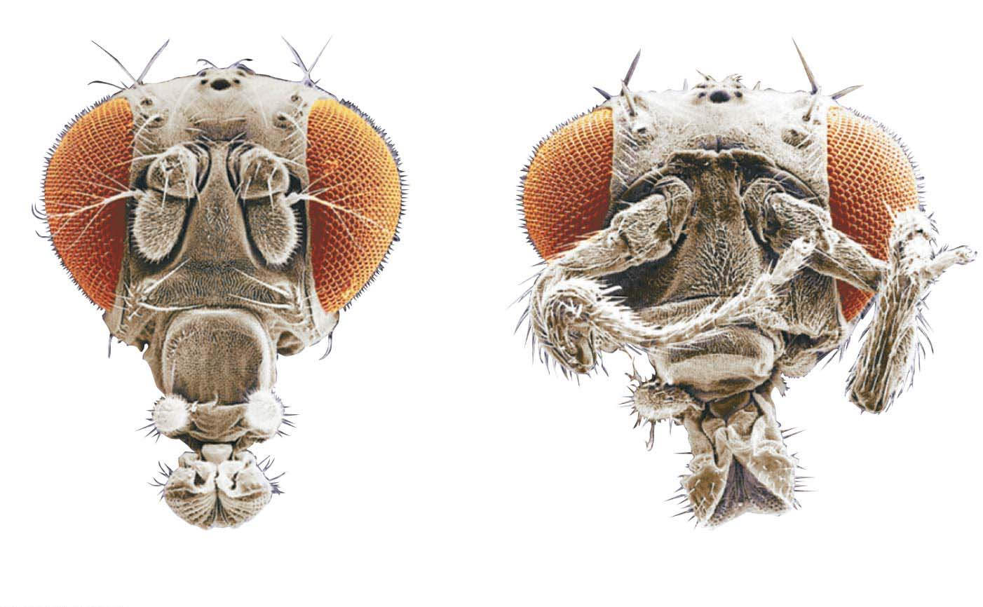
Homeotic Genes (同源基因) , Master Control Genes
In early embryonic development, homeotic genes regulate groups of other genes that determine what body parts will develop in which locations (the development of anatomical structures).
Antenna（触须）
Eye
Extra pair
of legs
Normal head due to presence
of normal homeotic gene
Head with extra legs growing due to
presence of mutant homeotic gene

Slide 36
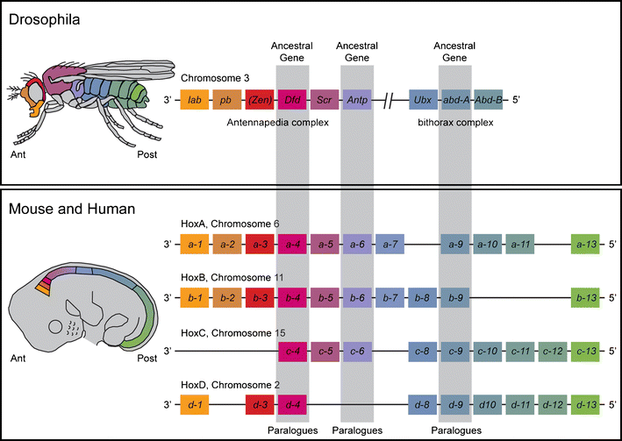
Homeotic Genes in Fruit Flies, Mouse, and Human
Pang, D., Thompson, D.N.P. Embryology and bony malformations of the craniovertebral junction. Childs Nerv Syst 27, 523–564 (2011). https://doi.org/10.1007/s00381-010-1358-9

Slide 37
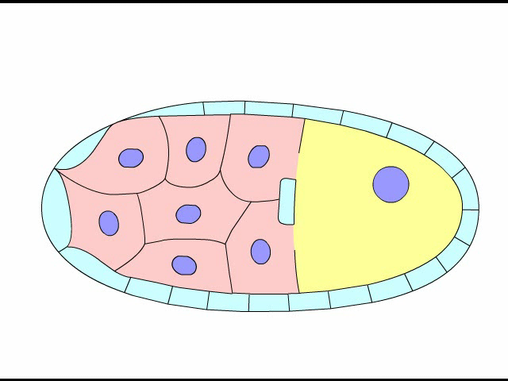
Development of Head-Tail Axis in Fruit Flies

Slide 38
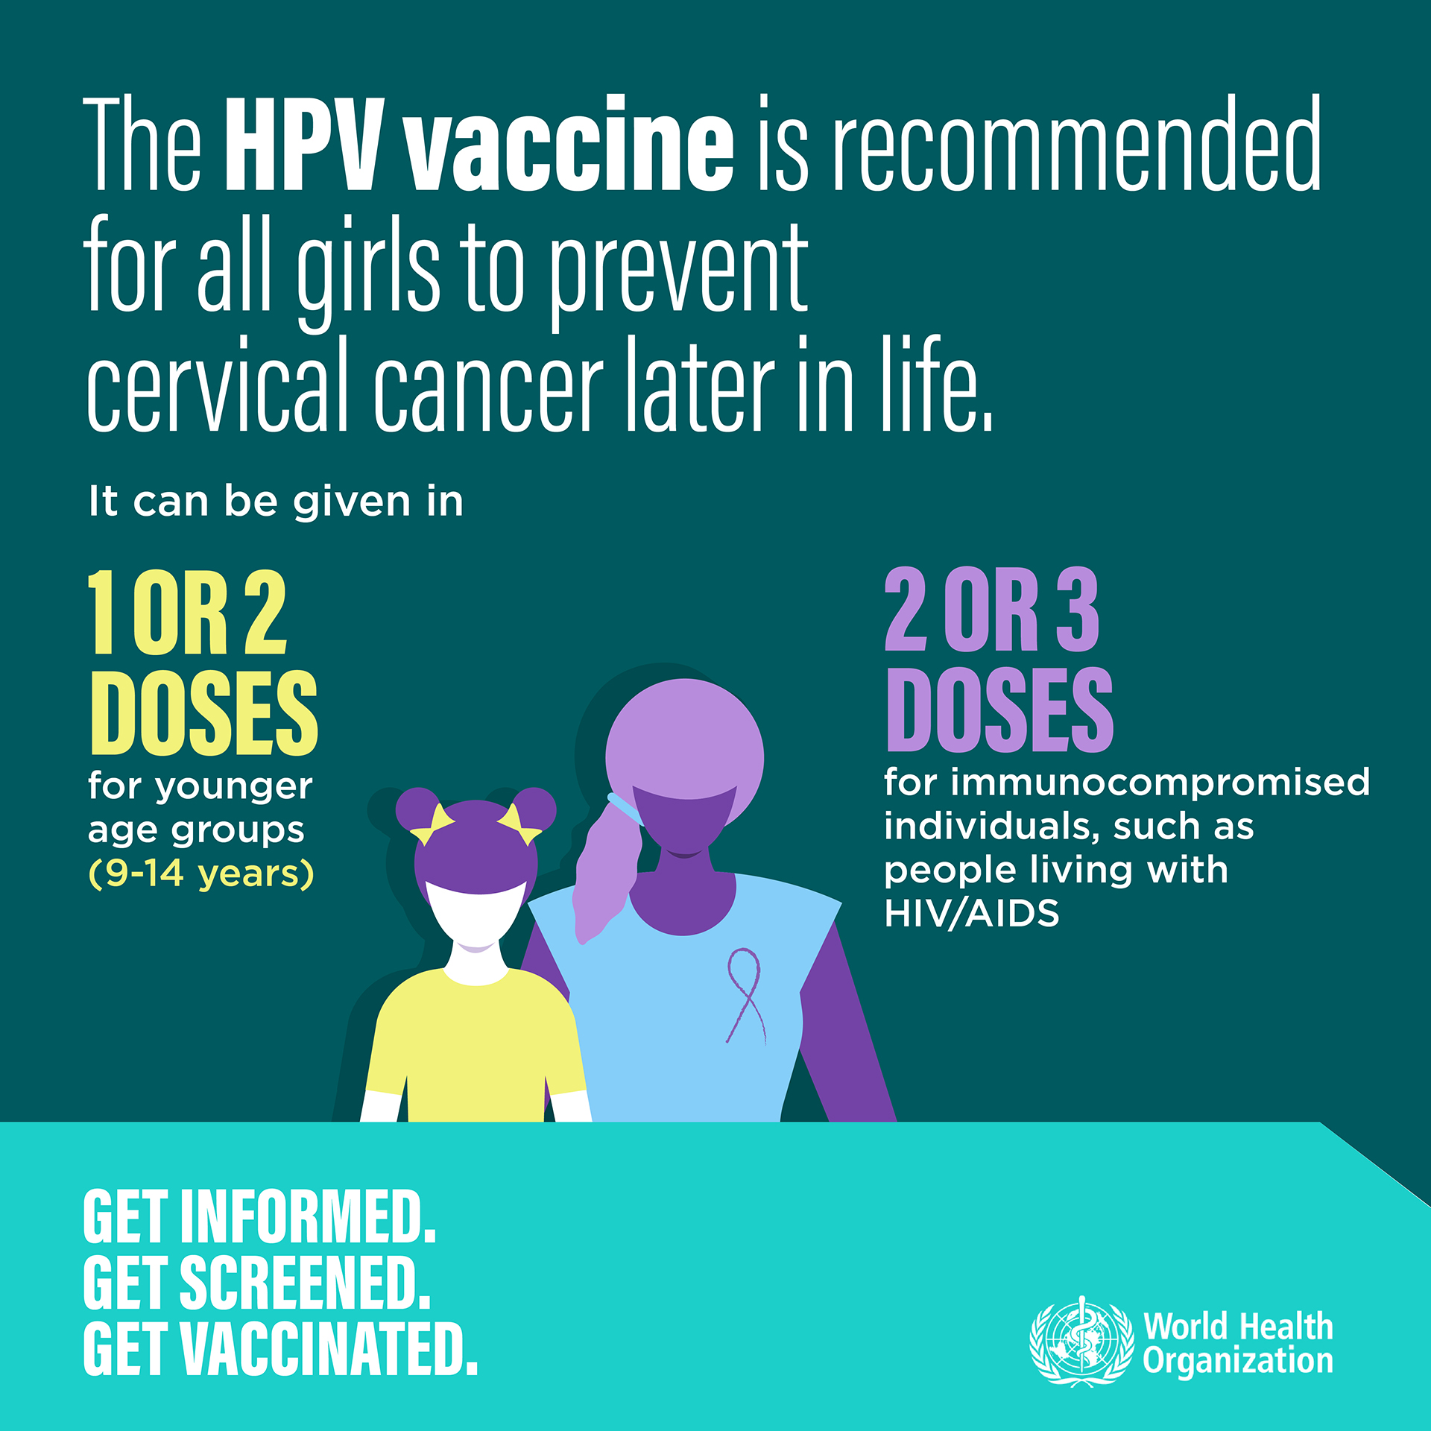
The Genetic Basis of Cancer
Viruses with cancer-causing genes
  Human papillomavirus (HPV)→ cervical cancer
Oncogene (“onco-”, tumor)
Tumor-suppressor genes
https://share.google/images/YIGLMXHTGWZ3h2j4J

Slide 39
Oncogenes (致癌基因), “GO”
Oncogene, a gene that causes cancer
Proto-oncogene (原癌基因), a normal, health gene with the potential (if changed, mutated) to become a cancer-causing oncogene.
A cell can acquire an oncogene from
  a virus
  the mutation of one of its own proto-oncogenes
Many proto-oncogenes code for growth factors, proteins that stimulate cell division, or for other proteins that affect the cell cycle.

Slide 40
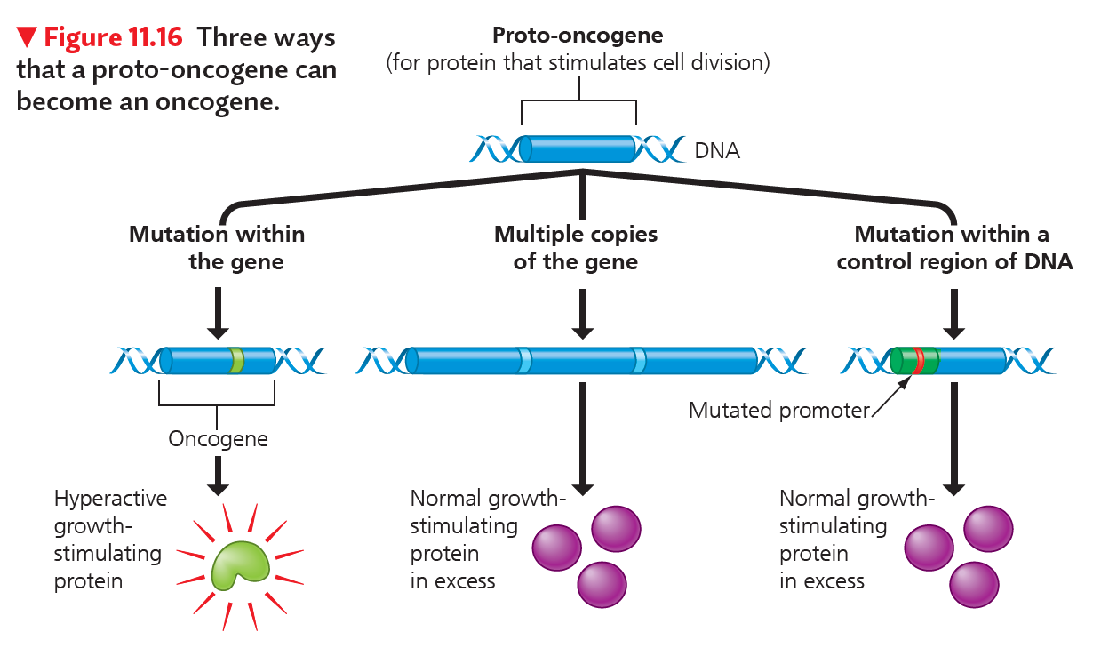
Abnormal Gene Expression Stimulates the Cell to Divide Excessively

Slide 41
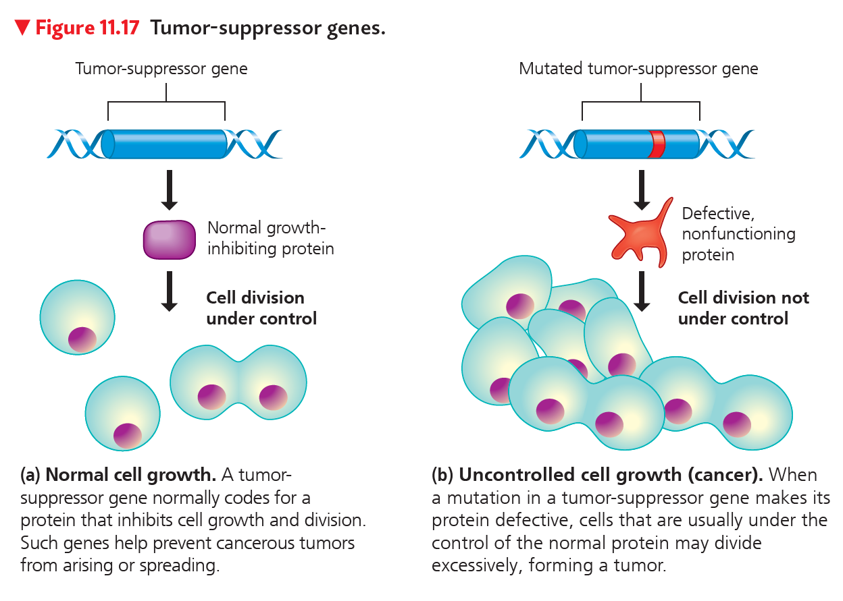
Tumor-Suppressor Genes (肿瘤抑制基因), “Stop”
Encode proteins normally help prevent uncontrolled cell growth.

Slide 42
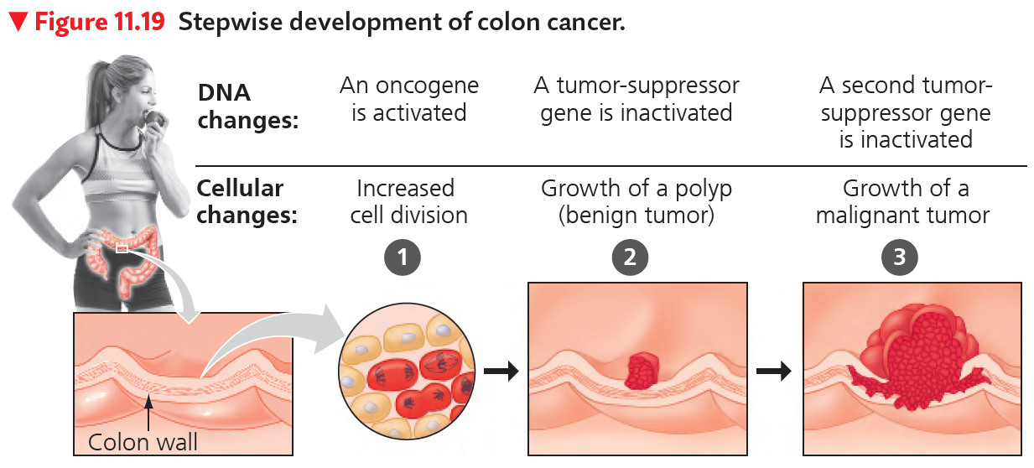
The Progression of a Cancer
A gradual process and produced by more than one mutation.
(息肉)

Slide 43
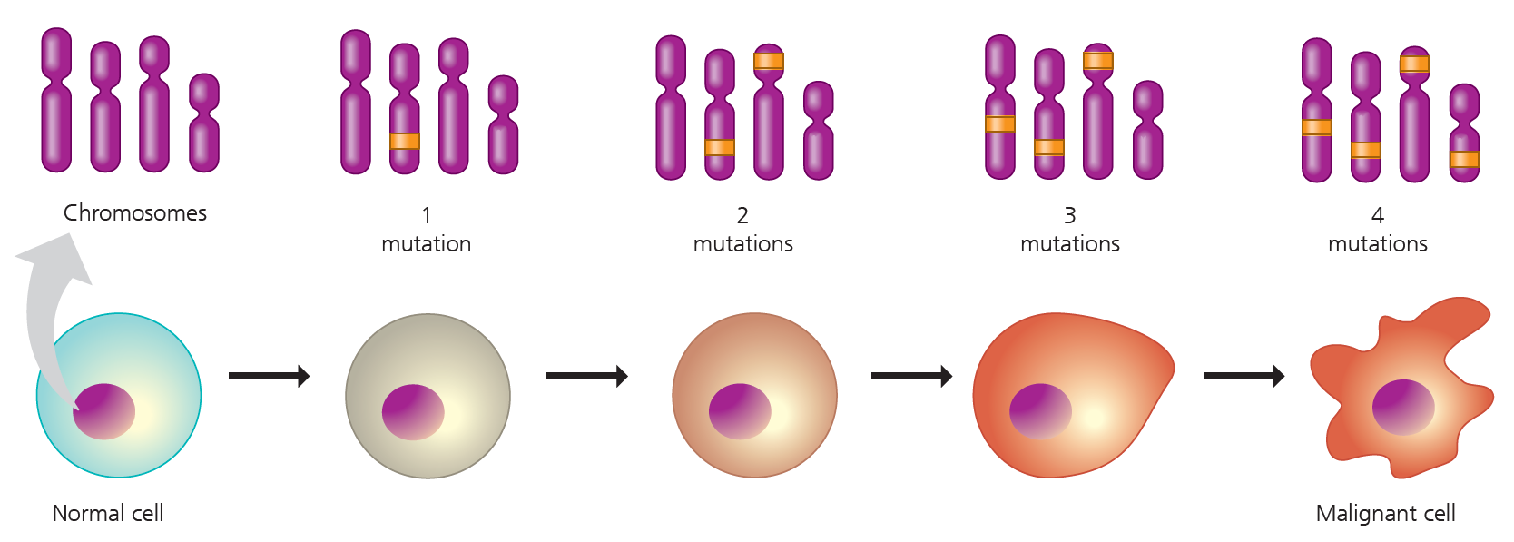
Accumulation of Mutations
typically takes at least six mutations (usually creating at least one active oncogene and disabling at least one tumor-suppressor gene)

Slide 44

Inherited Cancer
Cancers can run in families.
15% of colorectal cancers
5–10% of breast cancer
Proactive prevention by Angelina Jolie
  Inherited mutant BRCA1 (tumor-suppressor gene)

Slide 45

Cancer Risk by Carcinogens
Tobacco use, the consumption of alcohol, and excessive time spent in the sun are all avoidable behaviors

Slide 46
Cancer Prevention
Some food choices significantly reduce a person’s cancer risk
  20–30 g of plant fiber daily (one apple a day?)
  less animal fat
  Vitamins C and E and certain compounds related to vitamin A in fruits and vegetables
  Cabbage (卷心菜) and its relatives, such as broccoli (西兰花) and cauliflower (菜花)
Determining how diet influences cancer has become an important focus of nutrition research.

Slide 47
A Tumor Evolves, A Population of Cancer Cells
All evolving populations have the potential to produce more offspring than can be supported by the environment.
  Overproduction by cancer cells
Variation among individuals of the population
Variations in the population must affect survival and reproductive success.
  Mutations in cancer cells
    Less susceptible to normal mechanisms of reproductive control
    Passed on to descendants

